Slide 1

Smart Checkout Nexus: CLC Final Project Summary
CST-326 Written and Verbal Communication for Software Development
By: Alex Frear
Grand Canyon University
Instructor: Stephanie Macuga
Notes:
Hello everyone, my name is Alex Frear, and I’m excited to present a summary of my final project: Smart Checkout Nexus. This project was developed for CST-326, and it focuses on the design and implementation of a self-checkout system that enhances the customer experience while supporting attendants and integrating backend systems. I’ll walk through the application overview, Agile development process, challenges faced, and how I simulated collaborative teamwork while managing the project solo.

Slide 2
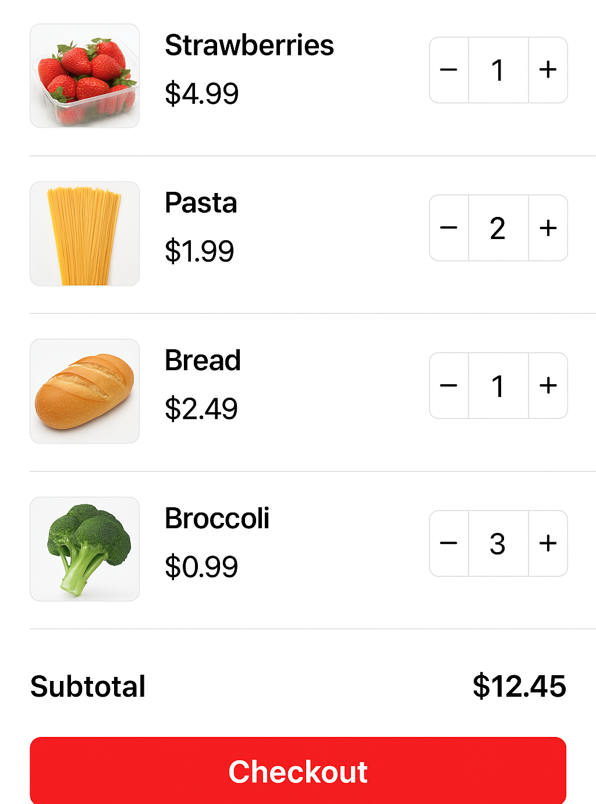
Project Overview
A self-checkout application designed to streamline retail transactions, improve attendant support, and integrate smoothly with backend systems like SAP.
Notes:
The Smart Checkout Nexus project was designed to simulate a real-world self-checkout system. It provides an intuitive interface for customers to scan items, manage their cart, request assistance, and choose a receipt method. It also includes an attendant interface for handling escalations and overrides. The application is structured to reflect modern retail technology standards and focuses on user-friendly design and system efficiency.

Slide 3

Challenges Encountered
Examples:
Balancing customer and attendant interface design
Aligning Trello cards with evolving user stories
Simulating team collaboration solo
Notes:
Several challenges arose during the course of the project. One of the biggest was managing both the customer and attendant interfaces as a solo developer. Balancing feature parity and consistent design across both sides of the system took a lot of planning. Another challenge was staying organized using Agile techniques without a real team—so I had to simulate daily standups and manage the entire product backlog through Trello. Maintaining testability and scope discipline was also critical as I progressed through the milestones.

Slide 4

Agile Roles and Process
List Agile roles simulated:
Product Owner (story creation, backlog refinement)
Scrum Master (facilitated sprints, reviewed burndown metrics)
Development Team Member (created wireframes, logic flow, documentation)
Agile Processes:
Weekly sprint planning with Trello
Simulated daily scrum via notes
Retrospectives conducted after each milestone
Notes:
To simulate a collaborative Agile environment, I assumed multiple Agile roles throughout the project. As the Product Owner, I created and refined user stories. As the Scrum Master, I structured sprint planning and retrospectives, even though I was working solo. And as the Developer, I implemented features and tracked progress. I used Trello as my Agile board, with clearly labeled cards representing user stories, test cases, and progress milestones. I structured weekly sprints and performed regular backlog grooming to keep things on track.

Slide 5

Process Changes
Examples:
Switched from general wireframes to labeled, color-enhanced ones after feedback
Refined Trello labels mid-project for better clarity
Introduced a “Complete” column in Trello during Milestone 5 to track version progression
Notes:
Throughout the course of the project, I refined my workflow and made several process adjustments. For example, I upgraded wireframes from grayscale to full-color, labeled visuals after realizing how much clearer they became for stakeholders. I also introduced a new ‘Milestone Complete’ Trello column to better track progress across deliverables. These changes helped keep documentation organized and enhanced communication—even in a simulated environment.

Slide 6
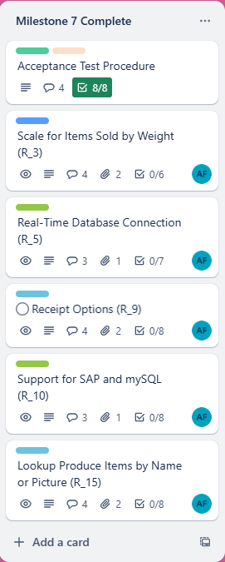
Product Backlog Statistics
Issues completed: 15 functional, 5 non-functional requirements
Known issues remaining: 3 (R_1, R_6, NFR_4)
Notes:
In total, the backlog included 15 functional requirements and 5 non-functional requirements. Of those, 17 were fully implemented by the end of the final milestone. A few known issues were deferred for post-release consideration, including some user experience enhancements. I tracked these in Trello using an ‘Open Issues’ column. This structured approach helped ensure that the most critical functionality was prioritized and completed.

Slide 7

Quality Metrics Overview
Metric list:
Login Response Time
Produce Lookup Accuracy
Sprint Velocity
Acceptance Test Pass Rate
Trello Completion Rate
Notes:
To assess project quality, I defined five key metrics:
Login Response Time – to evaluate system responsiveness
Produce Lookup Accuracy – to assess search precision
Sprint Velocity – to measure story point completion across sprints
Acceptance Test Pass Rate – to evaluate test coverage and success
Trello Completion Rate – to reflect actual productivity over time These metrics gave me insight into performance, efficiency, and progress reliability.

Slide 8
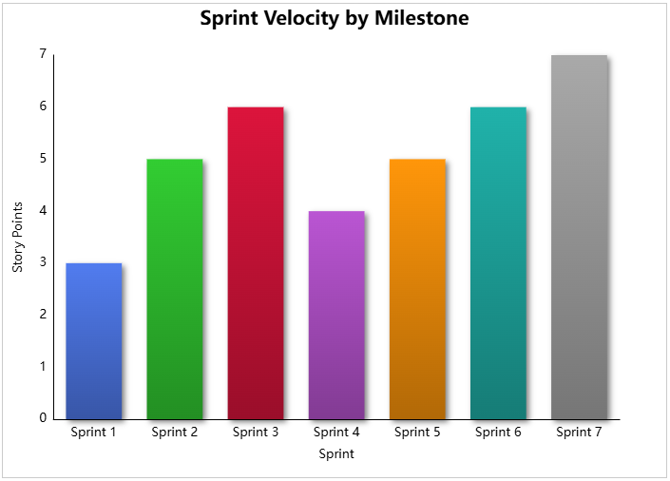
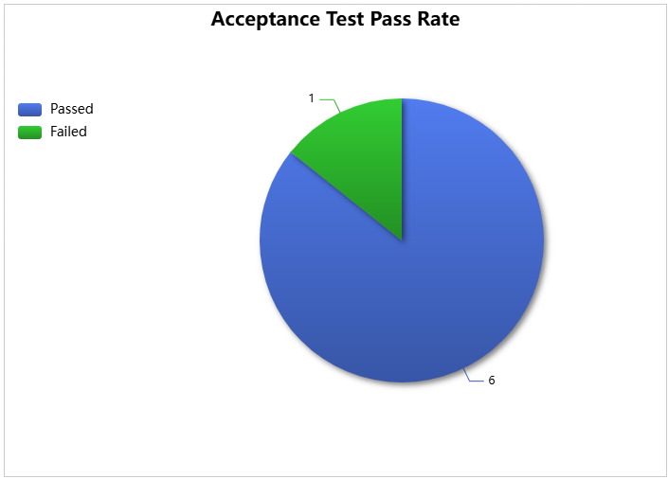
Metric Results Summary
Notes:
Looking at the results:
Sprint velocity showed steady progress, peaking in the final two sprints.
Acceptance tests had an 85.7% pass rate, with 6 out of 7 cases passing. The single failed case was documented and prioritized for future resolution.
Lookup accuracy was above 90%, indicating the system reliably surfaced correct produce items. These metrics validated that the project met its quality goals and that the Agile process I followed contributed to consistent delivery.

Slide 9
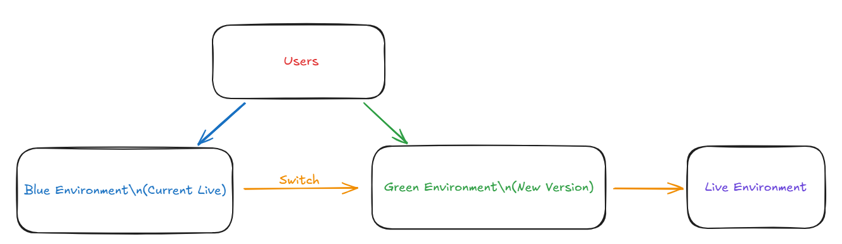
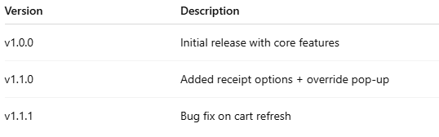
Deployment Strategy & Versioning
Deployment Strategy:
Used a Blue-Green Deployment strategy to allow testing in a live-like environment before switching over production traffic, minimizing risk during feature updates.
Versioning Approach:
Adopted Semantic Versioning format (MAJOR.MINOR.PATCH) to track release stages. Initial release was v1.0.0 with planned updates for minor enhancements and bug fixes.
Notes:
For deployment, I used a Blue-Green Deployment strategy to minimize risk and downtime. This allows the new version (Green) to be tested while the current version (Blue) remains live. Once confirmed stable, traffic is switched to Green. I also used Semantic Versioning to manage feature and bug-fix releases:
v1.0.0: Initial release
v1.1.0: Added features like receipt options and override pop-up
v1.1.1: Minor bug fixes
This structure keeps version history clear and trackable, essential for ongoing maintenance.

Slide 10

Training Plan
IT Administrator
Store Attendant
End Users (Customers)
Methods: Documentation, simulated walkthroughs, diagrams
Notes:
Training was designed for four distinct user groups:
IT Admins were provided with deployment and system maintenance guides.
Store Attendants received interface walkthroughs to handle override functions.
End Users (Customers) had intuitive UI elements and visual cues to guide them through the checkout flow.
Cloud Admins were included for infrastructure support. All training documentation was tailored to match each role's technical level and responsibilities.

Slide 11

Upgrade and Bug Fix Schedule
Weekly sprints for minor patches
Major upgrades after every 3 sprints
Open issue reassessment post-launch
Notes:
My update and bug fix plan used a sprint-based approach:
Weekly bug fixes were planned to address any newly discovered issues.
Major features were scheduled for delivery every three sprints.
Open issues would be reassessed during retrospective sessions and prioritized into the backlog.
This approach ensures that updates remain agile and focused on actual user needs while maintaining a stable production environment.

Slide 12
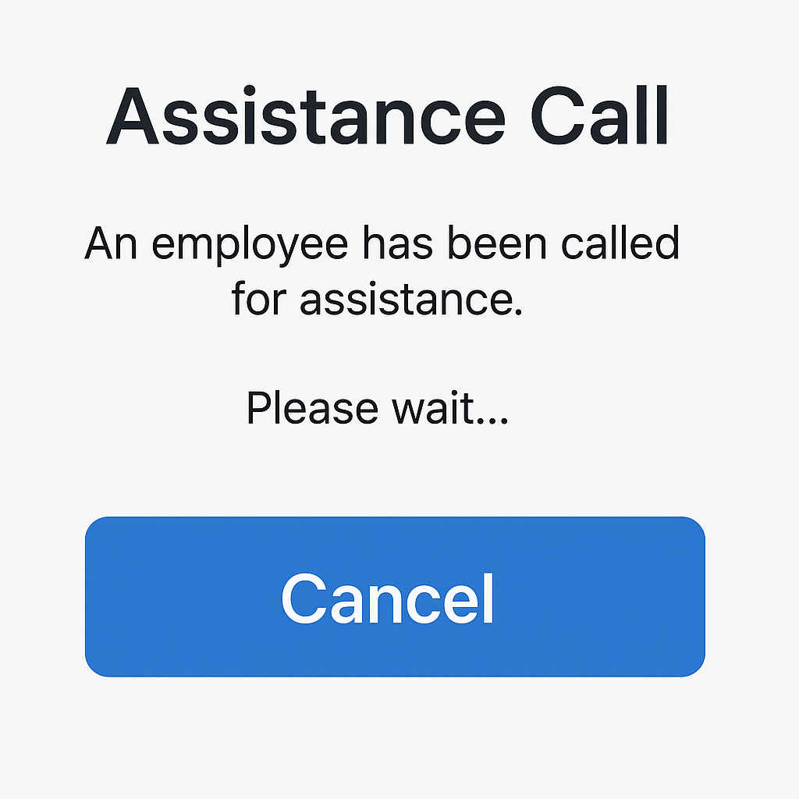
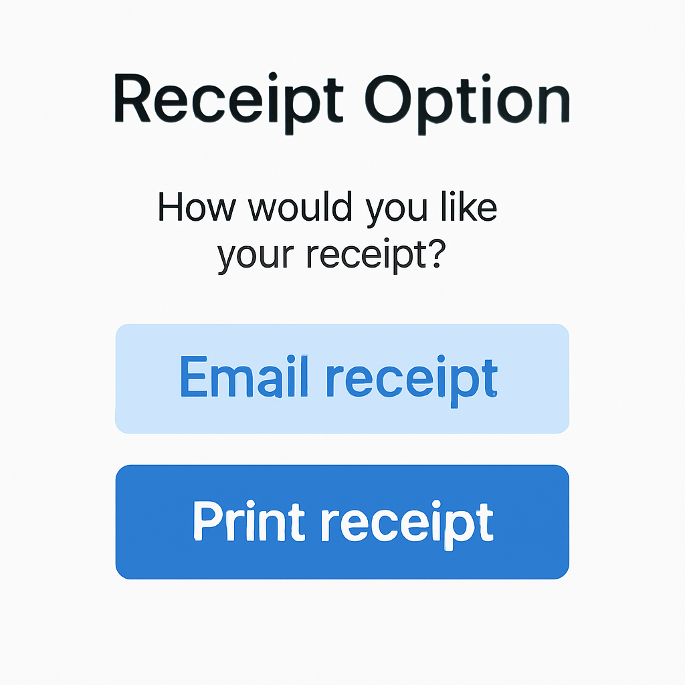
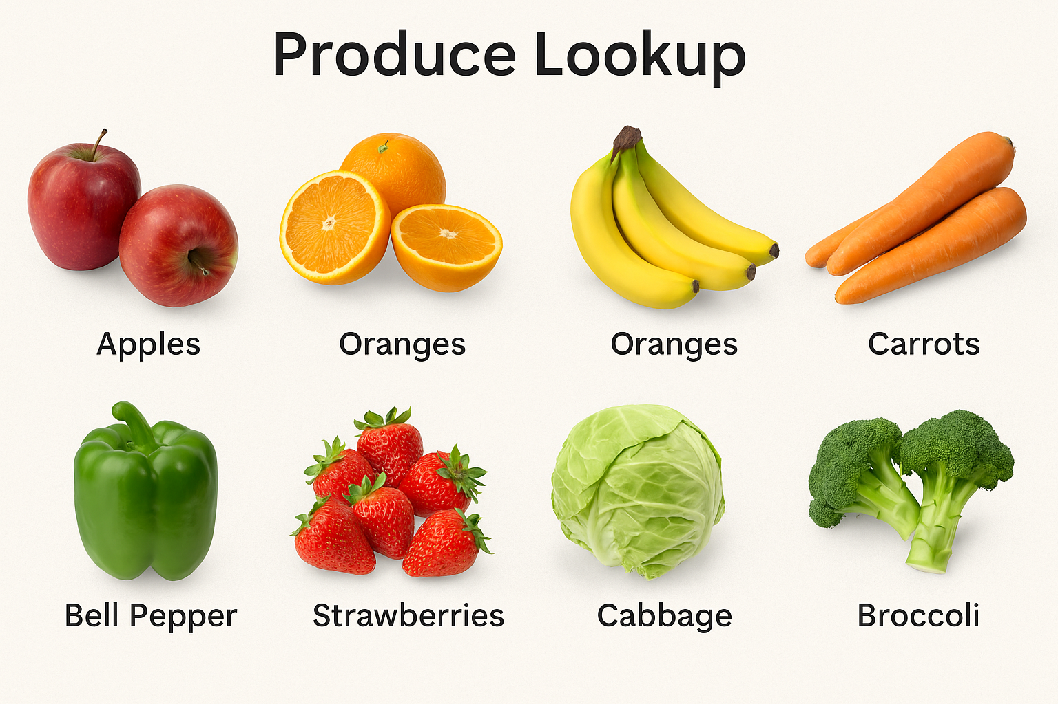
Final Thoughts and Live Demo Plan
Notes:
To wrap up, the Smart Checkout Nexus project achieved its goal of simulating a self-checkout solution that is both functional and user-focused. While this is not a live demo environment, I’ve prepared several simulated screens to showcase key features:
The Produce Lookup feature offers image-based item selection with keyword search.
The Assistance Call pop-up lets customers request help during checkout.
The Receipt Option screen presents a clean, easy way to choose between print and email.
These screens represent the culmination of Agile planning, design iteration, and quality-focused development. Thank you for your time and attention—I’d be happy to answer any questions about the project.

